Slide 1
ER DIAGRAM & DATABASE PROJECT
By
Motunrayo Akinsanya
05/23/2024

Slide 2
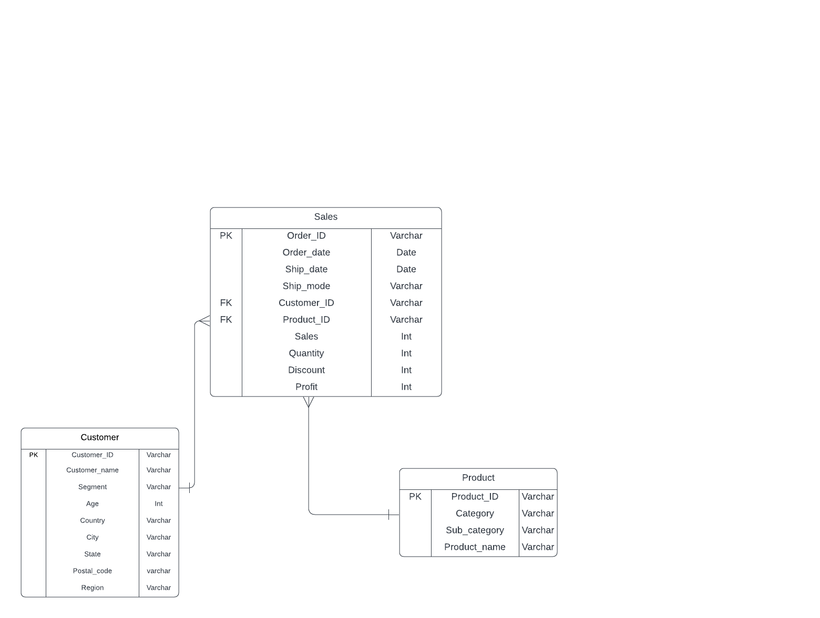
Entity-Relationship diagram for customer, sales, and product table

Slide 3
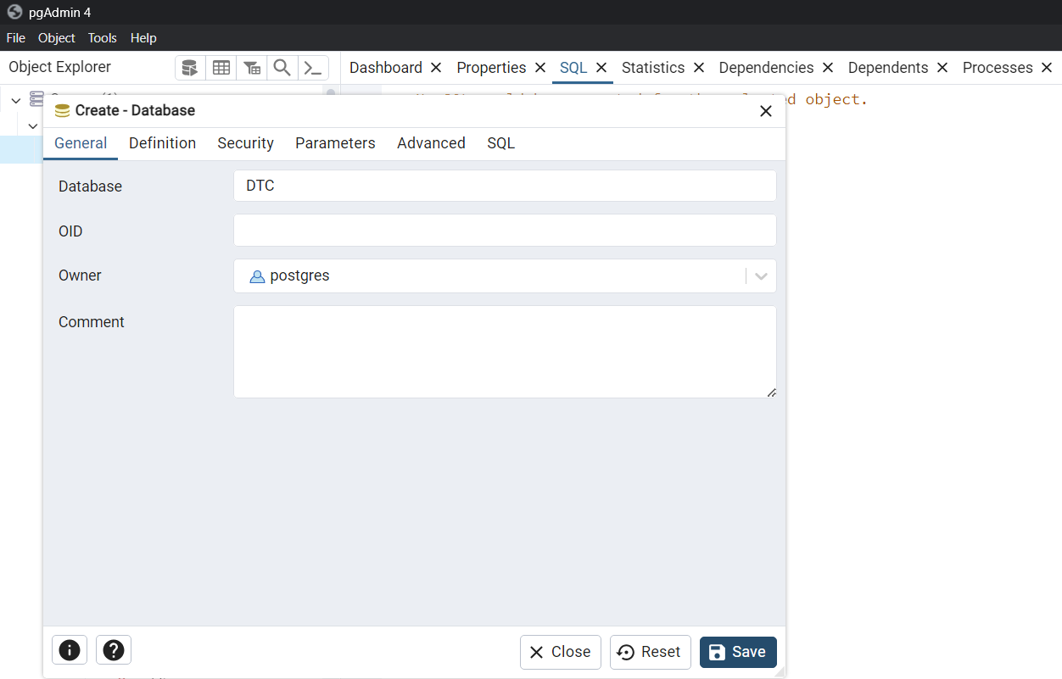
Create DTC database

Slide 4
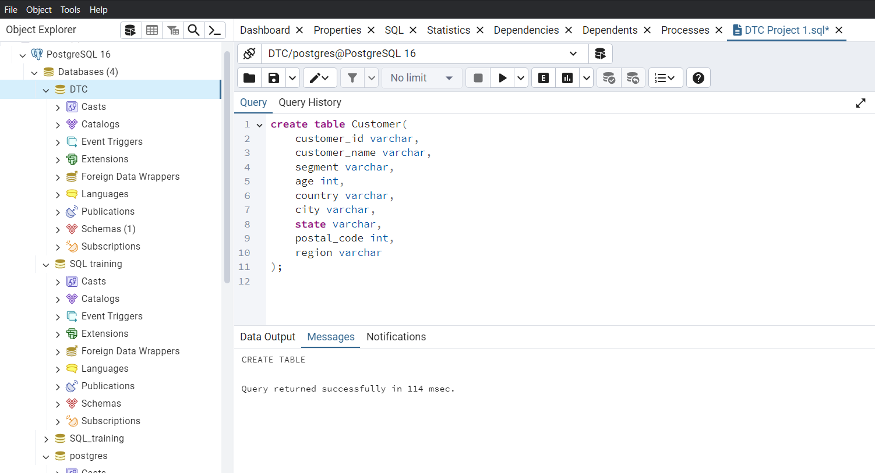
Code to create customer table

Slide 5
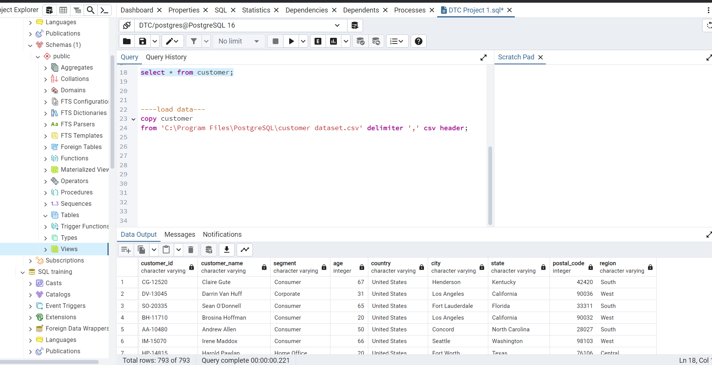
Code to load customer table data

Slide 6
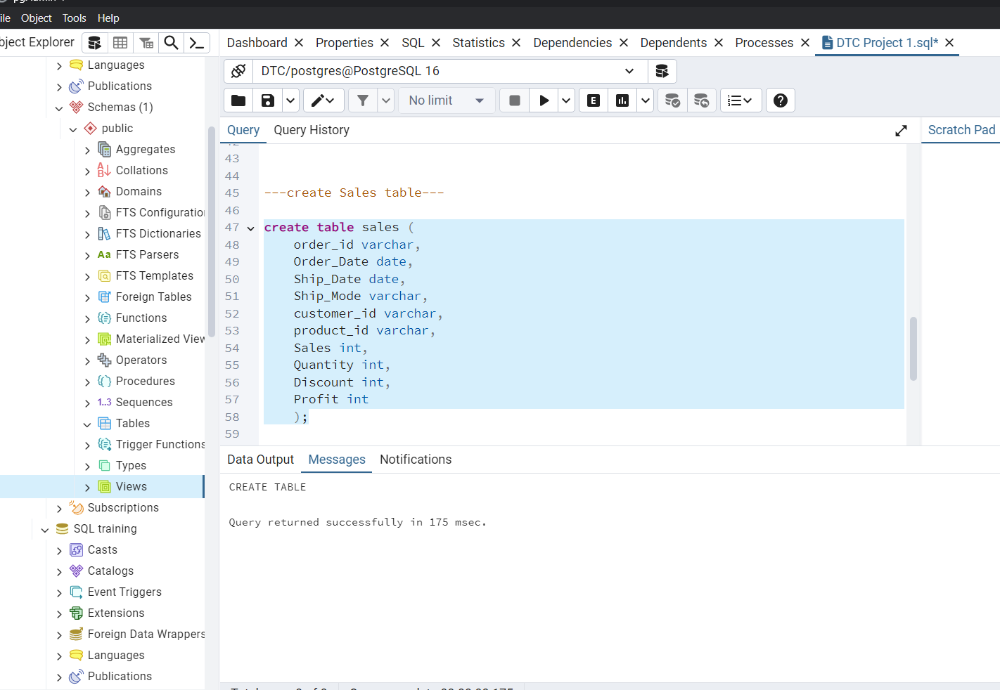
Code to create sales table

Slide 7
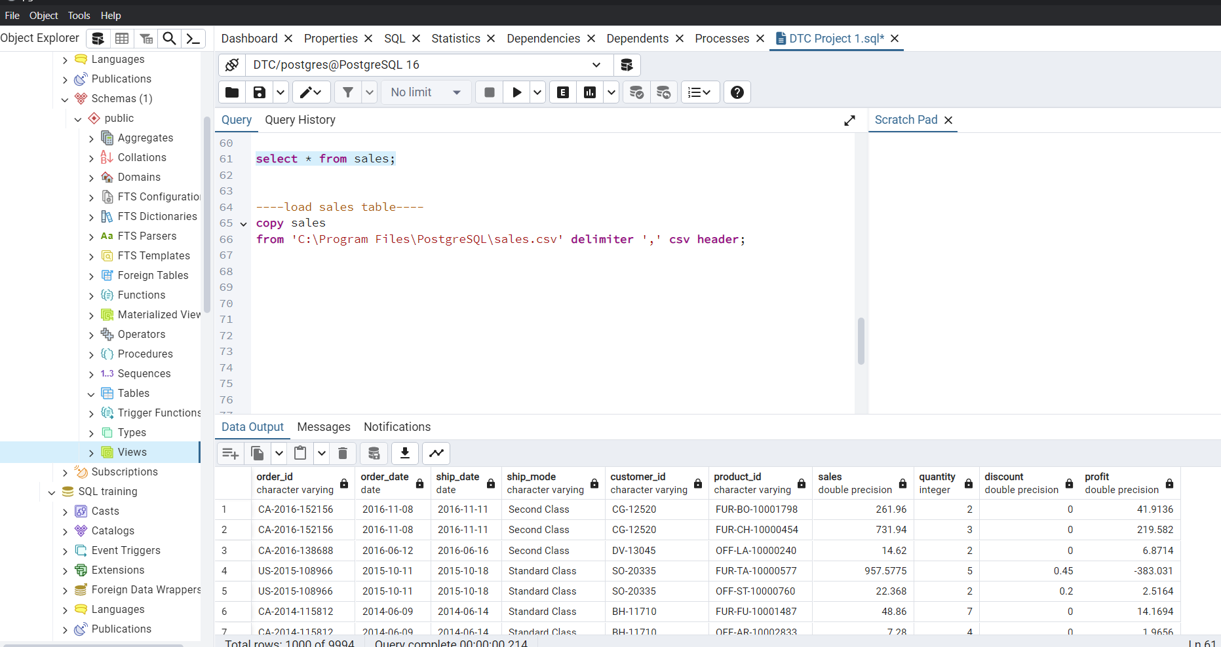
Code to load sales table data

Slide 8
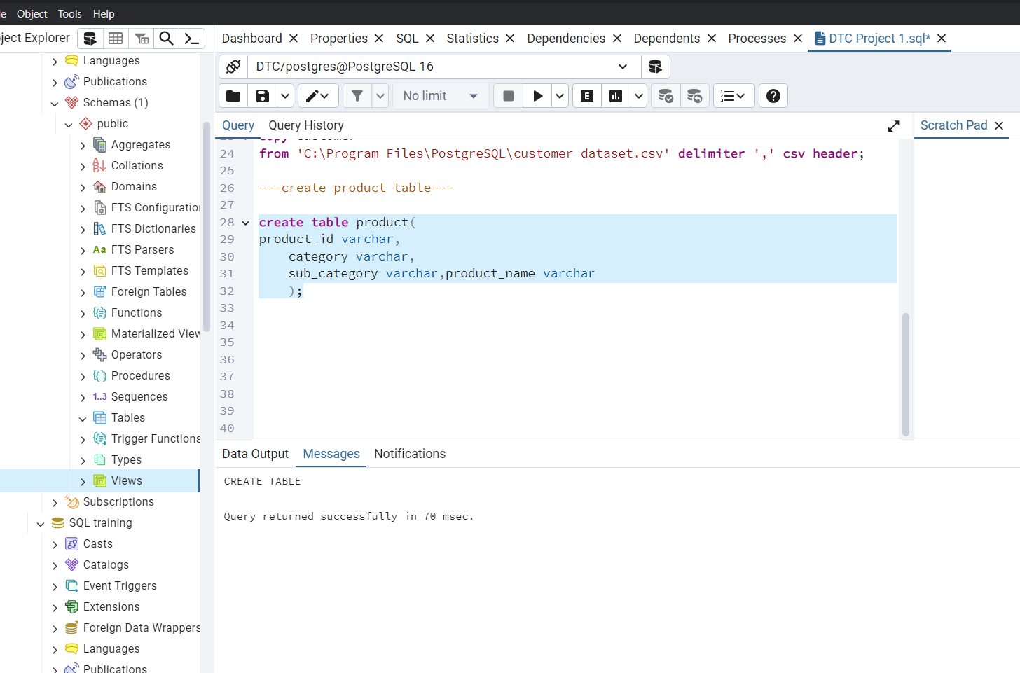
Code to create product table

Slide 9
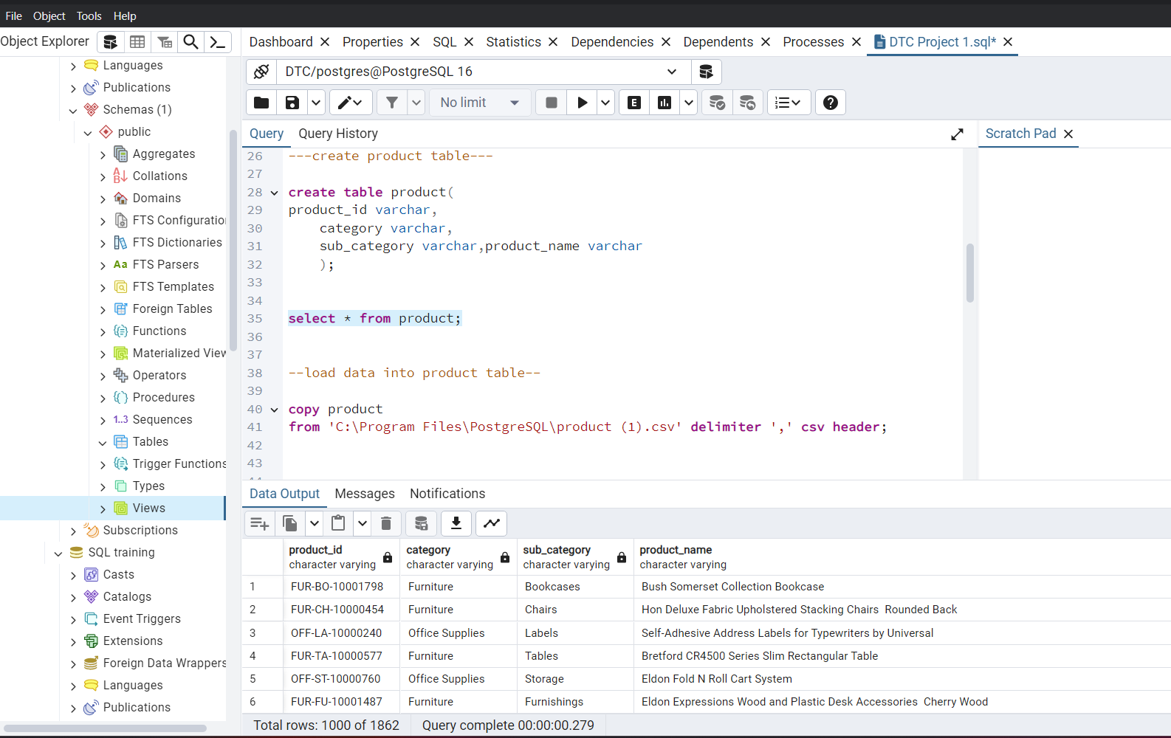
Code to load product table data

